Slide 1
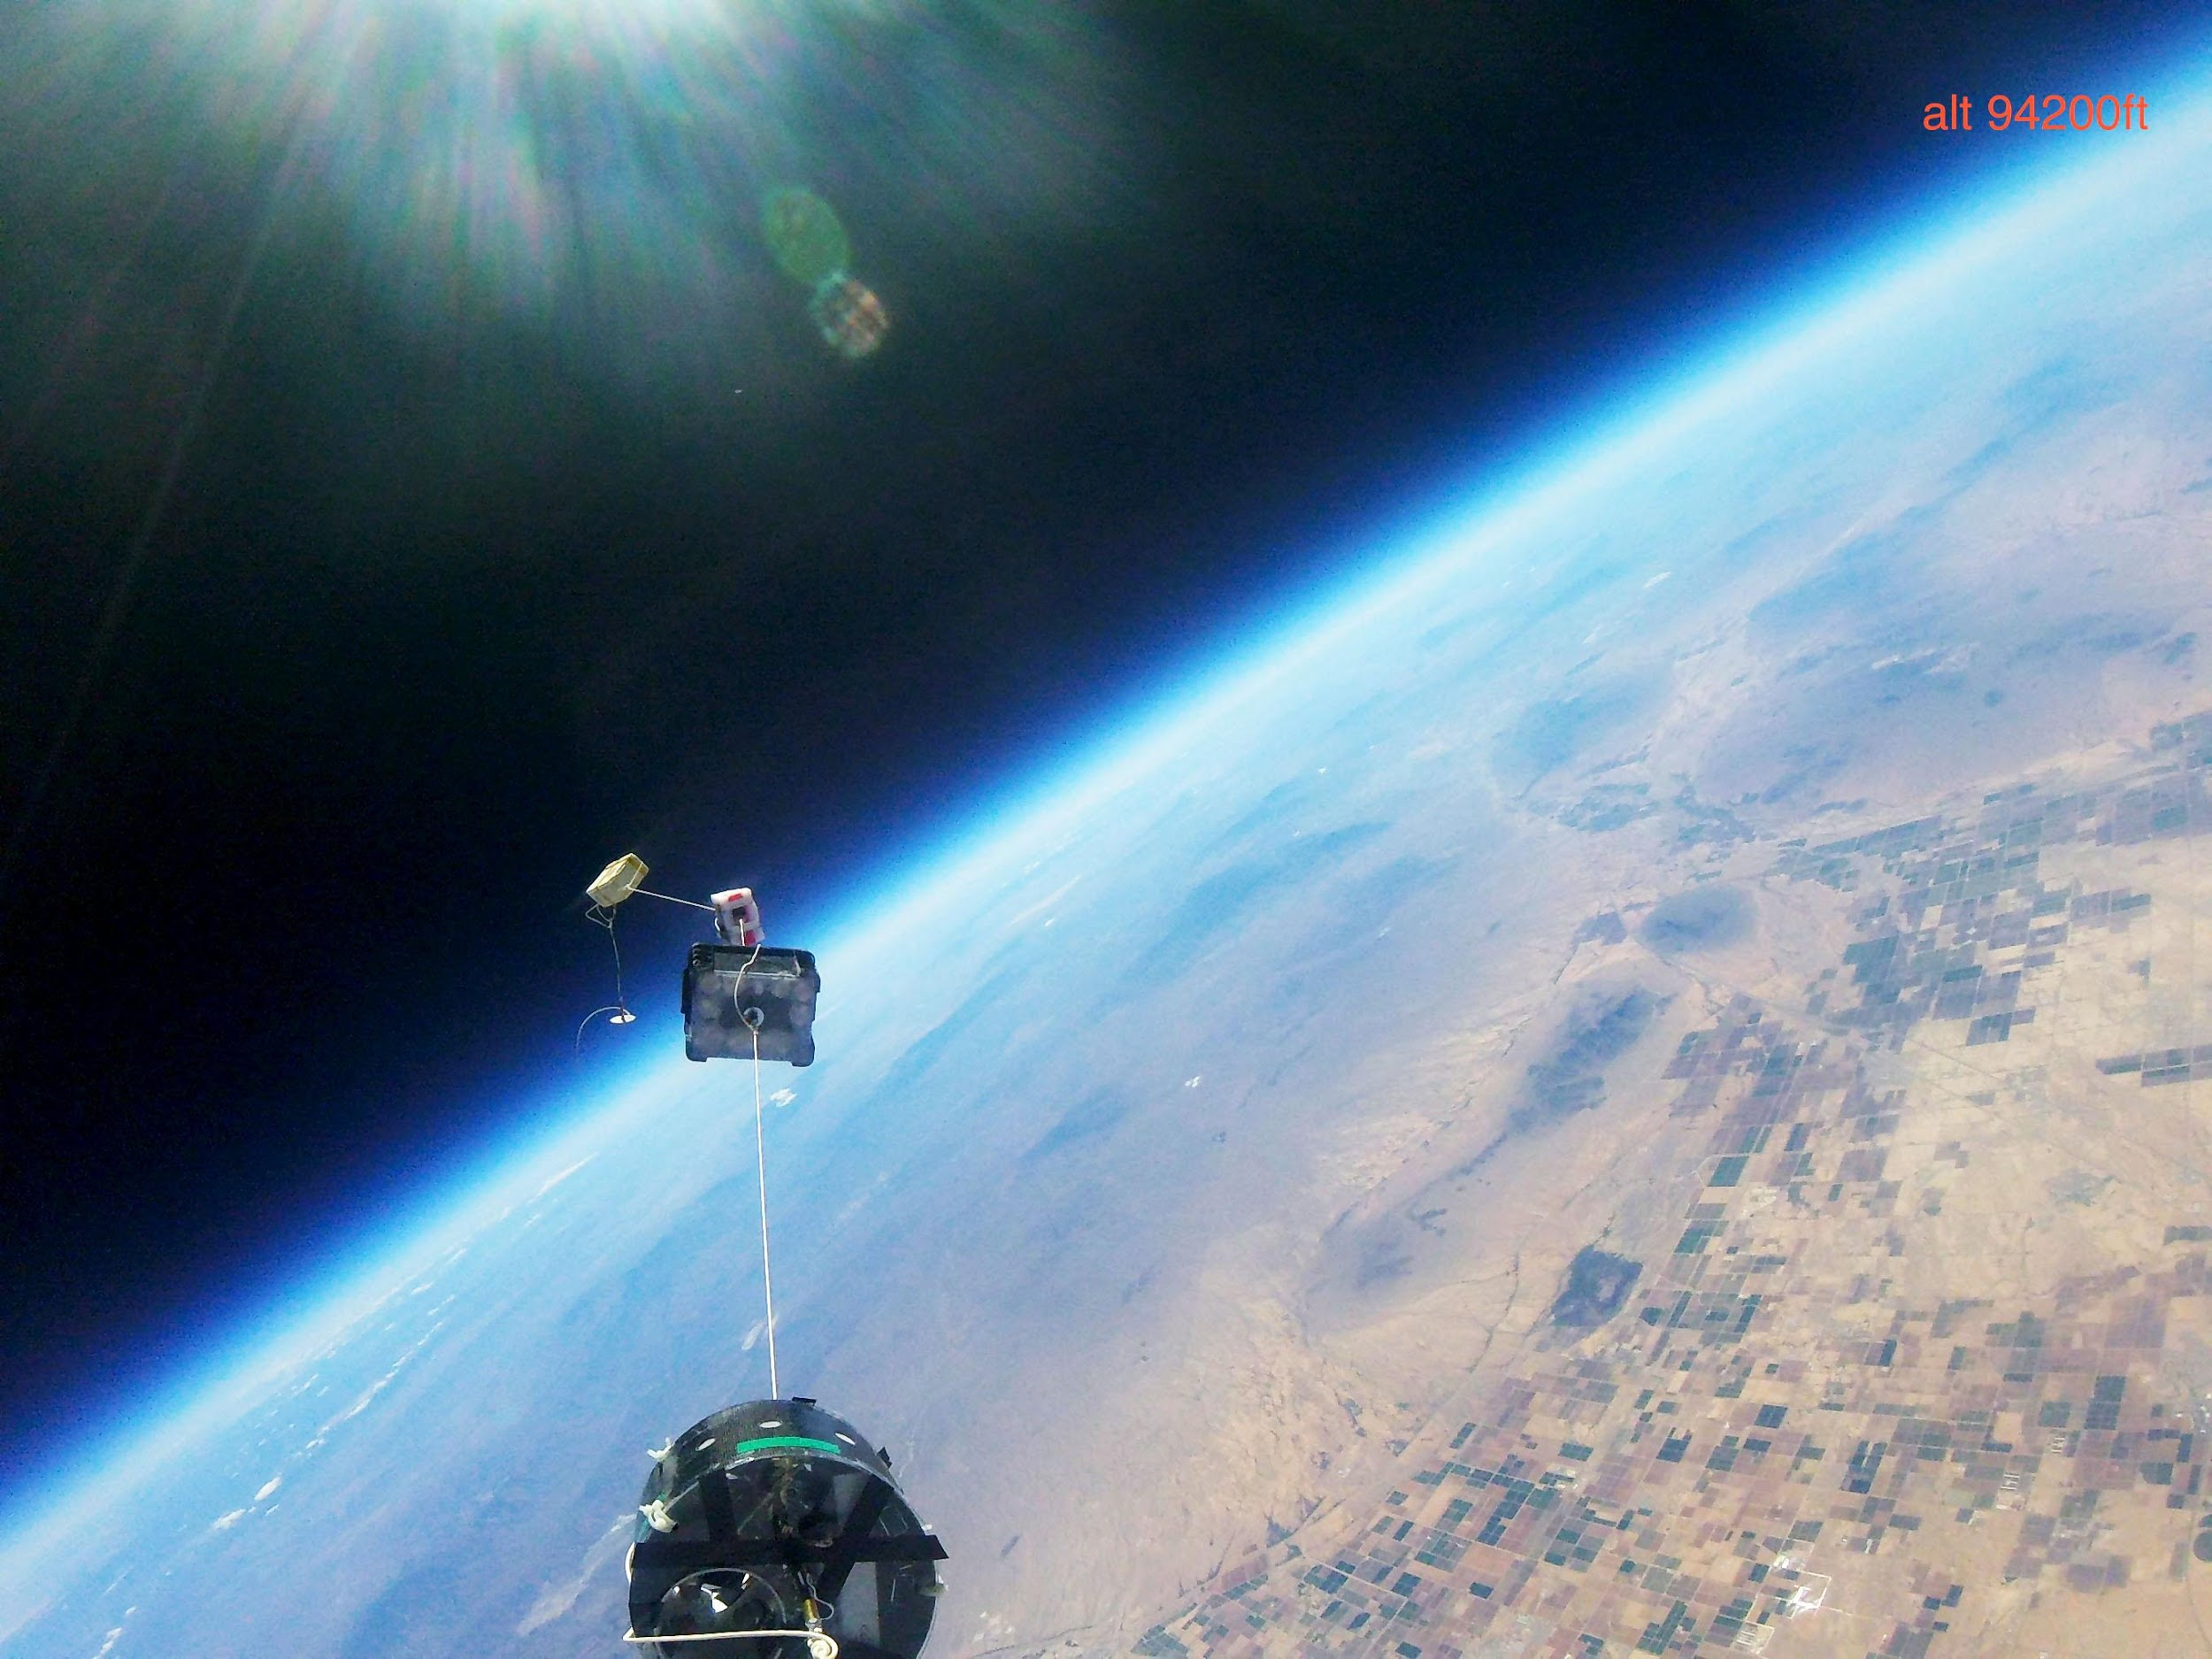





2017-2018
PHOENIX COLLEGE
NASA ASCEND SYMPOSIUM PRESENTATION

Slide 2

TEAM MEMBERS
Adam Jimenez
Yadira Estrada
Rosa Mendoza
Chris Barclay
Samuel Humpherys
Chris McCurry
Eunice Lopez*
Joel Perez*
Tracy Concialdi*
*Spring Volunteers

Slide 3
GOALS
FALL 2017
Develop an impact protection system within durable housing
Profile the atmosphere
Prove the existence of the Pfotzer Maximum

Slide 4
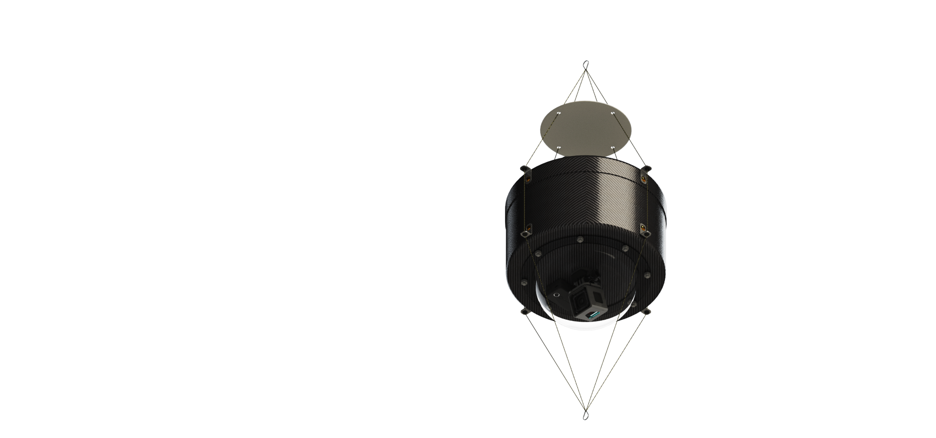
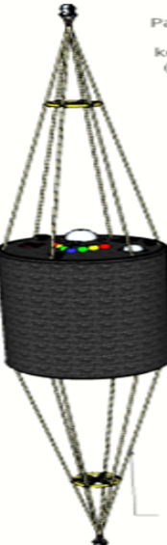
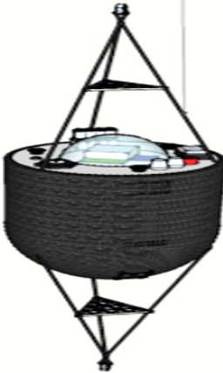
DESIGN
SUSPENSION:
Evolution of Design
HOUSING

Slide 5
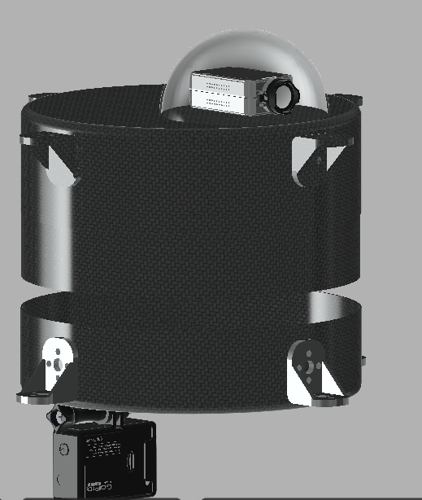
DESIN
HOUSING
DESIGN
HOUSING
EXTERIOR:
Carbon Fiber
Fiberglass
Small Acrylic Dome

Slide 6
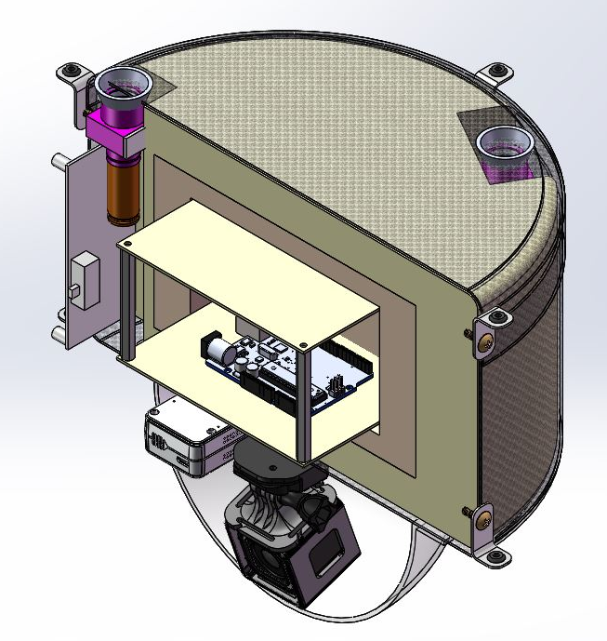
DESIN
HOUSING
DESIGN
INTERIOR
IMPACT PROTECTION SYSTEM:
3 Layer fiberglass plates
Polystyrene foam
Polyurethane foam

Slide 7

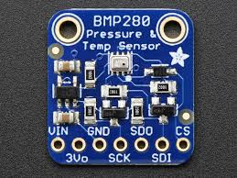
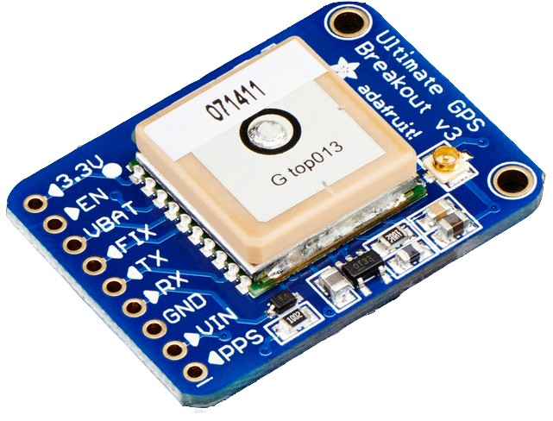
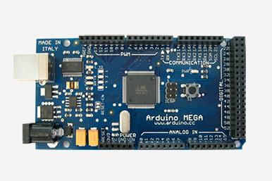
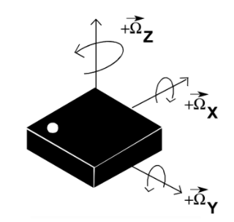
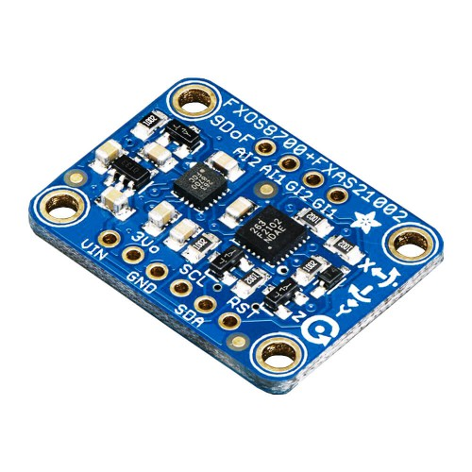
DESIGN
PAYLOAD:
Orientation
Global Positioning
Interior pressure temperature
ELECTRONICS

Slide 8

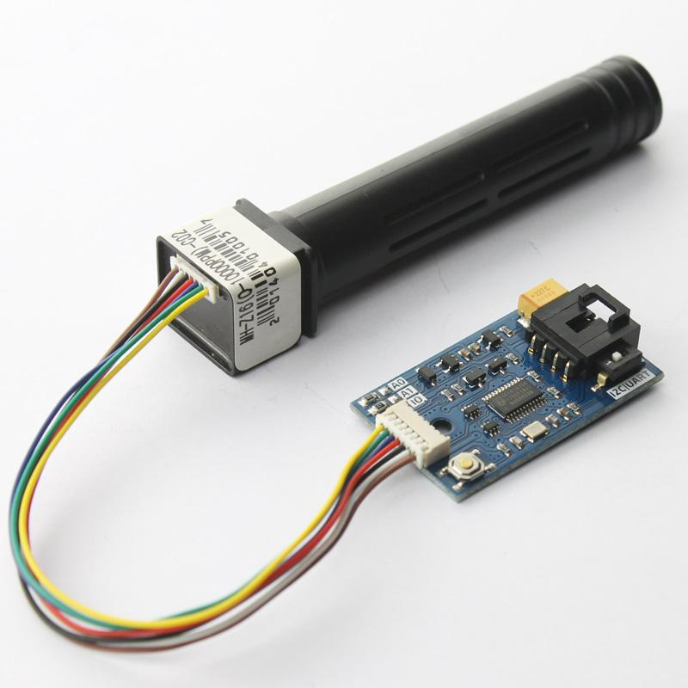
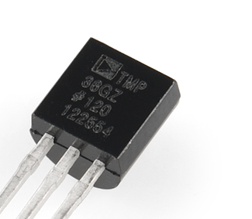
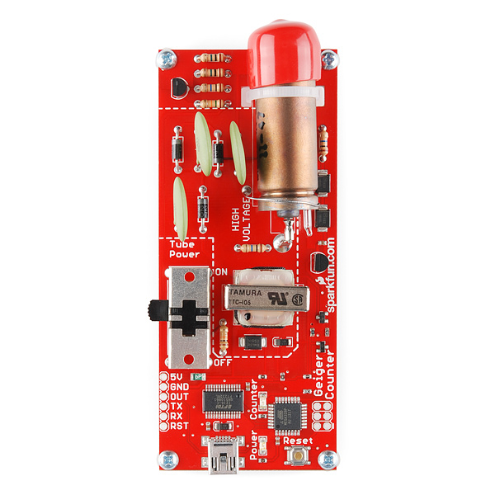
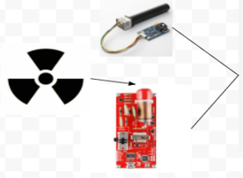
EXTERNAL ATMOSPHERIC DATA:
DESIGN
ELECTRONICS
CO2 sensor
Temperature
3-Geiger counters

Slide 9
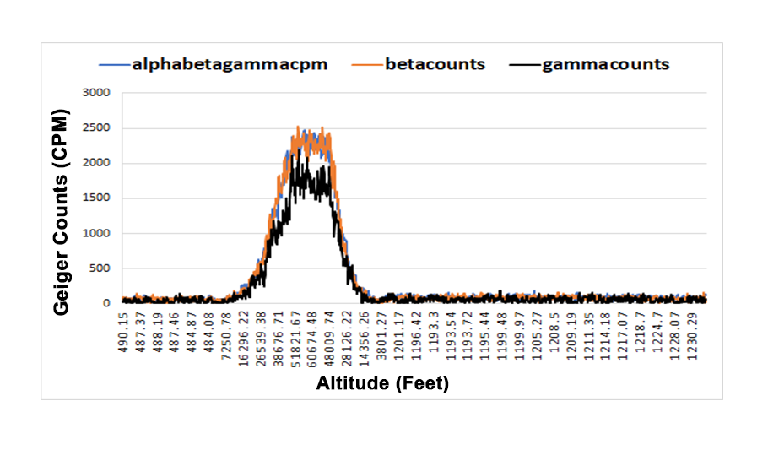
Science
Radiation Levels, Fall 2017
Radiation
Lower region of Pfotzer Maximum

Slide 10
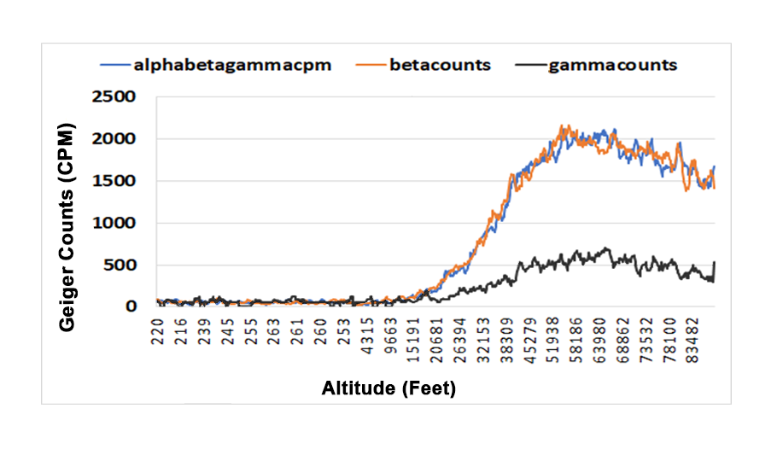
Science
Radiation Levels, Hamfest 2018
Radiation
Region that proves the Pfotzer Maximum exists

Slide 11
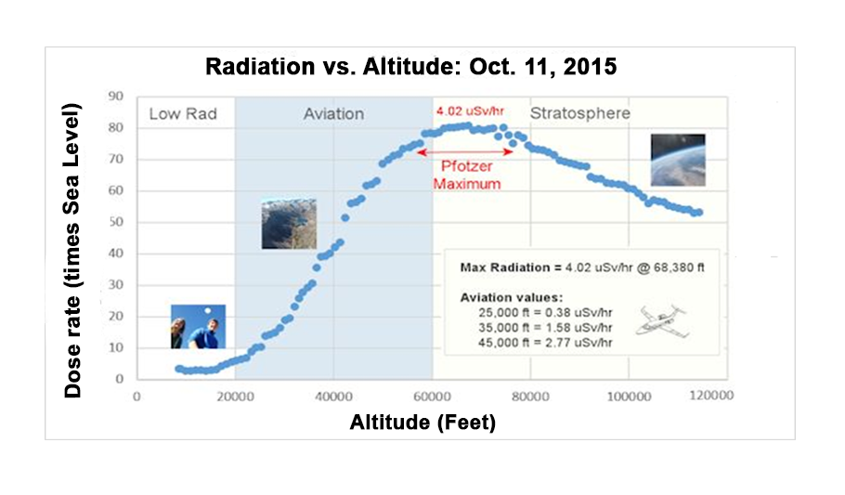
Radiation Levels: Independent Source
Science
Validation

Slide 12
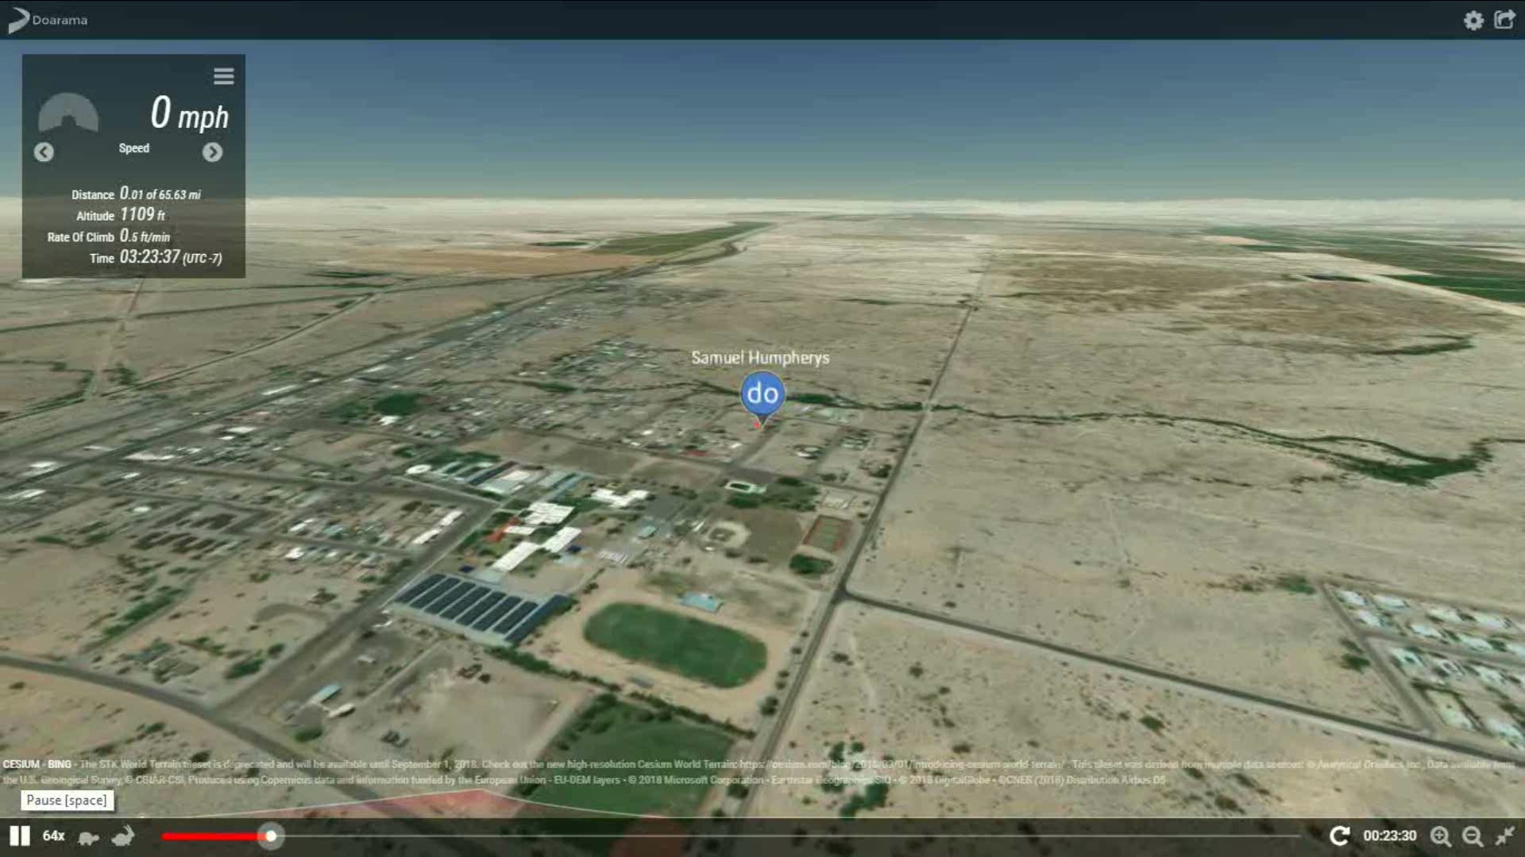
Science
Flight Path Simulation Fall 2017
Simulation

Slide 13
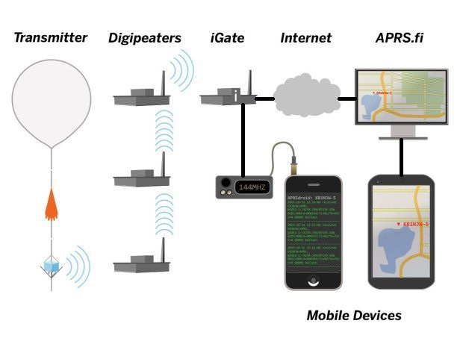
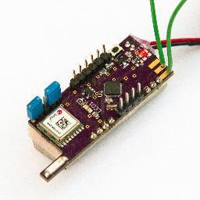
DESIGN
TELEMETRY:
Radio transmitter
APRS system
ELECTRONICS

Slide 14
GOALS
SPRING 2018
Establish long range communication with payload
Receive remote telemetry data for interpretation during flight
Create a live stream payload

Slide 15
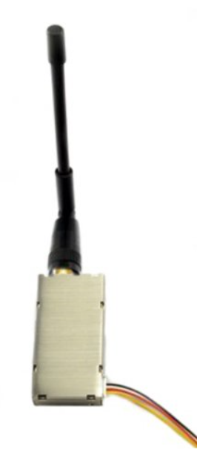
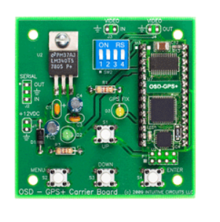
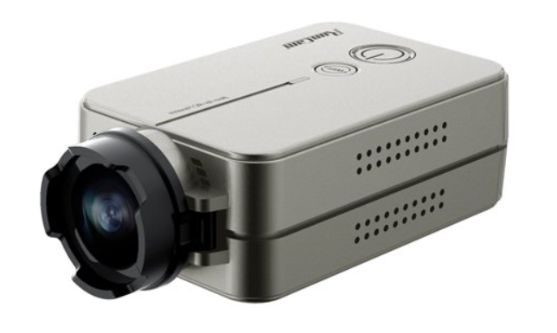
DESIGN
STREAMING VIDEO SYSTEM:
ELECTRONICS
RunCam (1080p)
On Screen Display
Transmitter (1.28GHz)

Slide 16
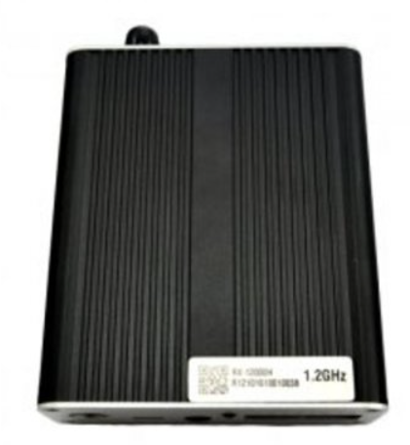

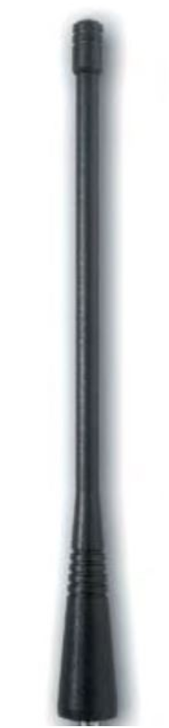


DESIGN
GROUND STATION:
ELECTRONICS
Antenna
Receiver
Capture card
Laptop
Hotspot

Slide 17
CONCLUSION
SPRING 2018
Pfotzer Maximum exists just above 60,000ft
Remote communication possible throughout flight
Ground station needs enhancements to sustain video streaming capabilities

Slide 18
THANK YOU!
ASCENDING FURTHER TEAM
Special thanks to:
Stephen Thomas
Susan Brew
Ernest Villicaña
Dr. Ed Ong
Paul Ronquillo

Slide 19
QUESTIONS?
Science validation graph provided by:
Phillips, T. (2015, Oct 11) SPACE WEATHER BALLOONING--LATEST RESULTS. Retrieved
from http://spaceweather.com/archive.php?view=1&day=23&month=10&year=2015

